Slide 1
Mental Healthcare Professional Shortages
File created on: 8/29/2021 4:50:34 AM

Slide 2
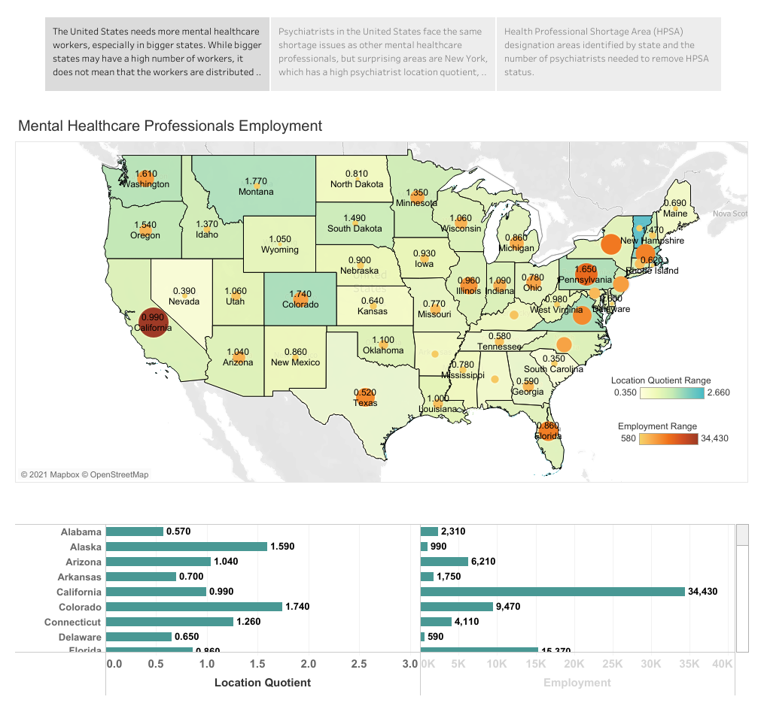

Slide 3
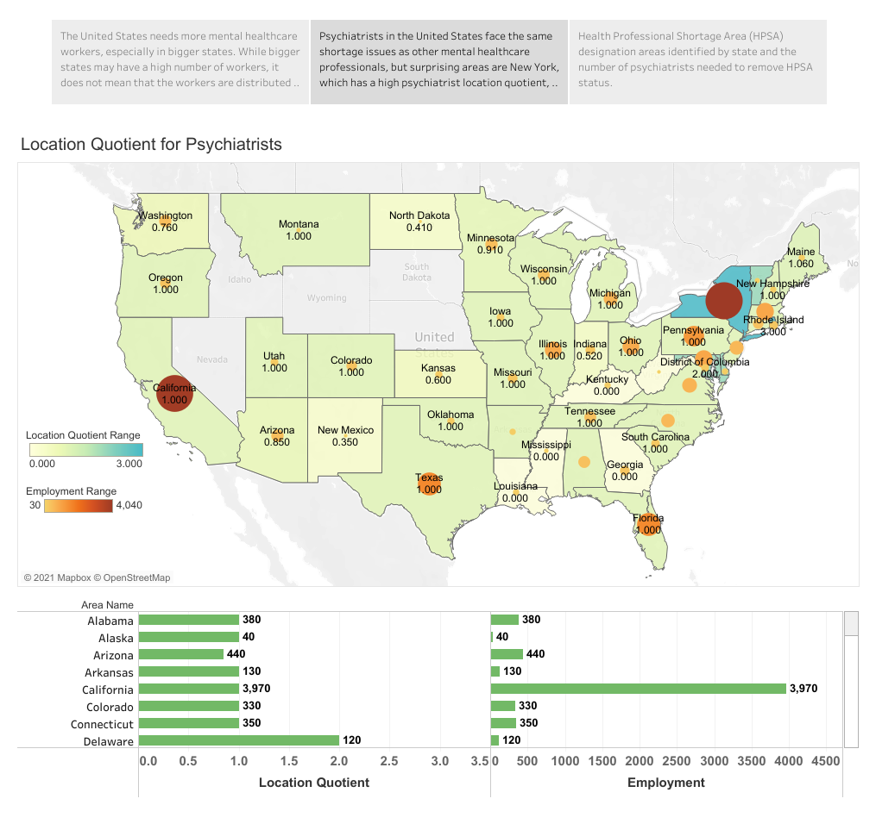

Slide 4
